Slide 1
DATA ANALYTICS
MINI PROJECT 2 – CORONA VACCINE
BY
Gladys Rubala M S,
Data Analytics Enthusiast

Slide 2
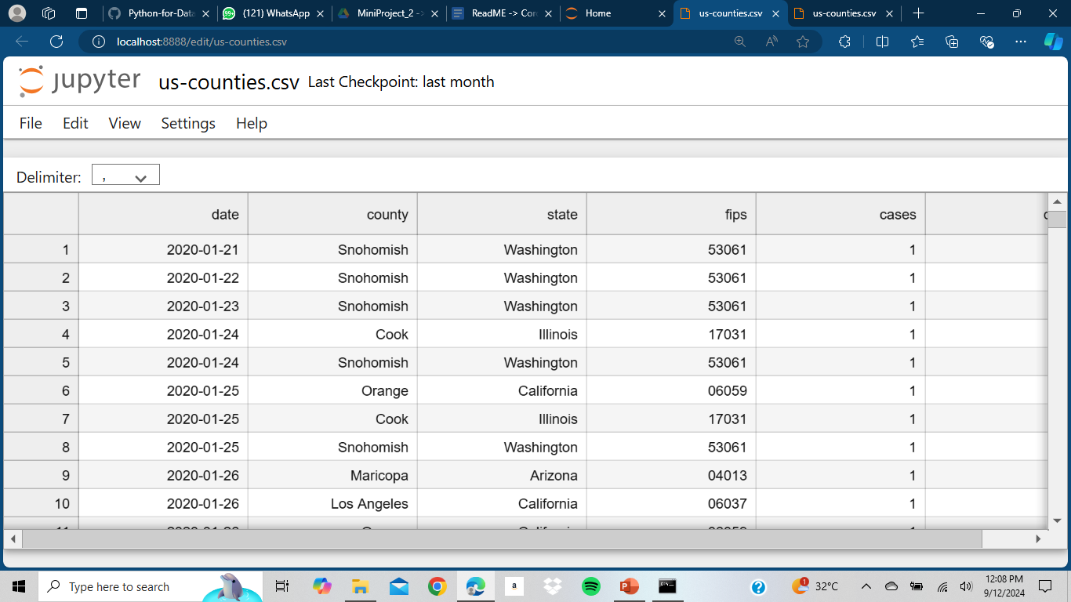
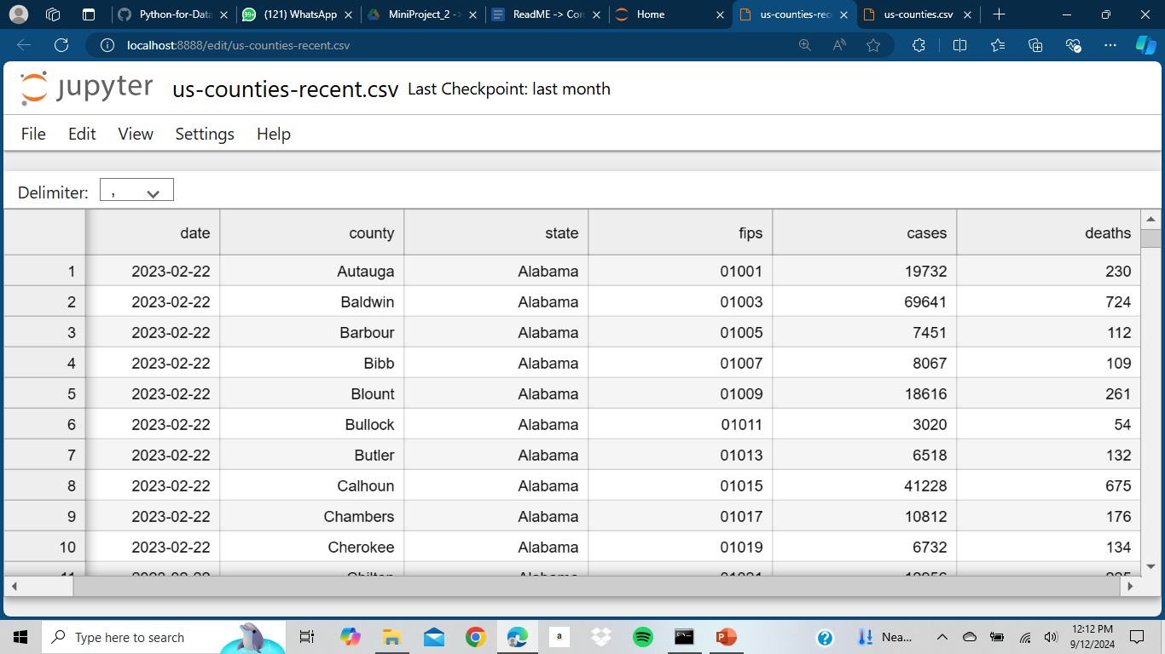
DATA SAMPLE
Us-counties.csv
Us-counties-recent.csv

Slide 3
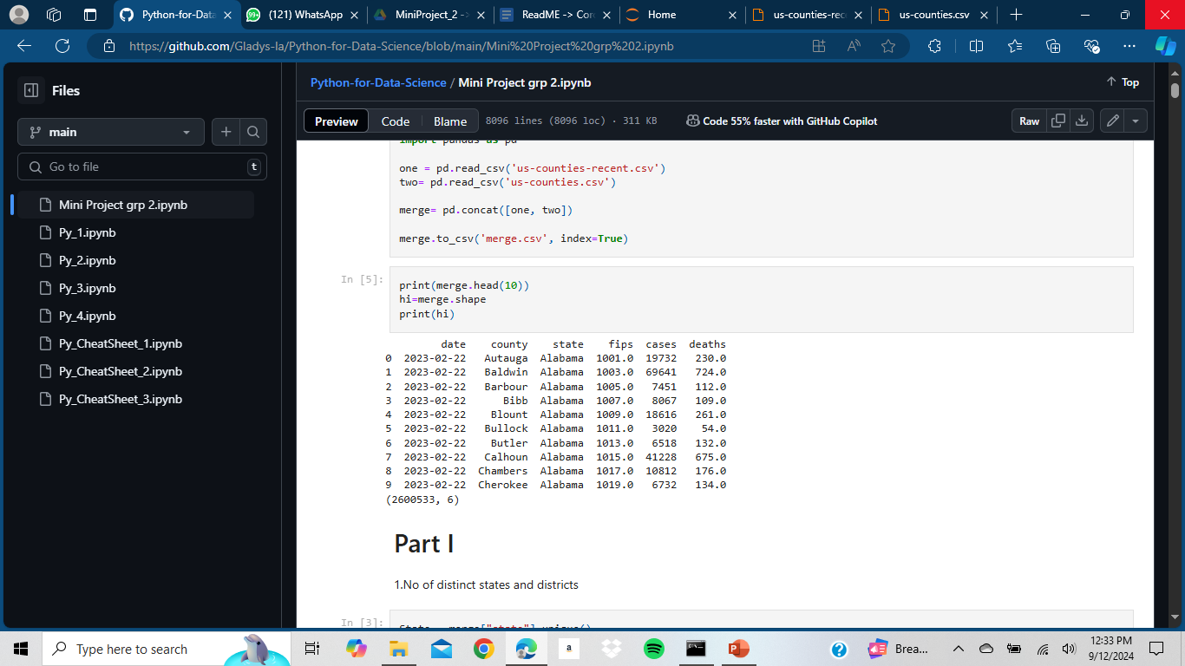
DATA PRE-PROCESSING Merge both us-counties.csv and us-counties-recent.csv files
Function Used:
pd.concat
pd.concat is a pandas function that concatenates two or more DataFrames, Series, or Panels along a particular axis.
It's a powerful tool for combining data from multiple sources into a single DataFrame.
.to csv
The .to_csv() method in pandas is used to write a DataFrame to a CSV file.
Output

Slide 4
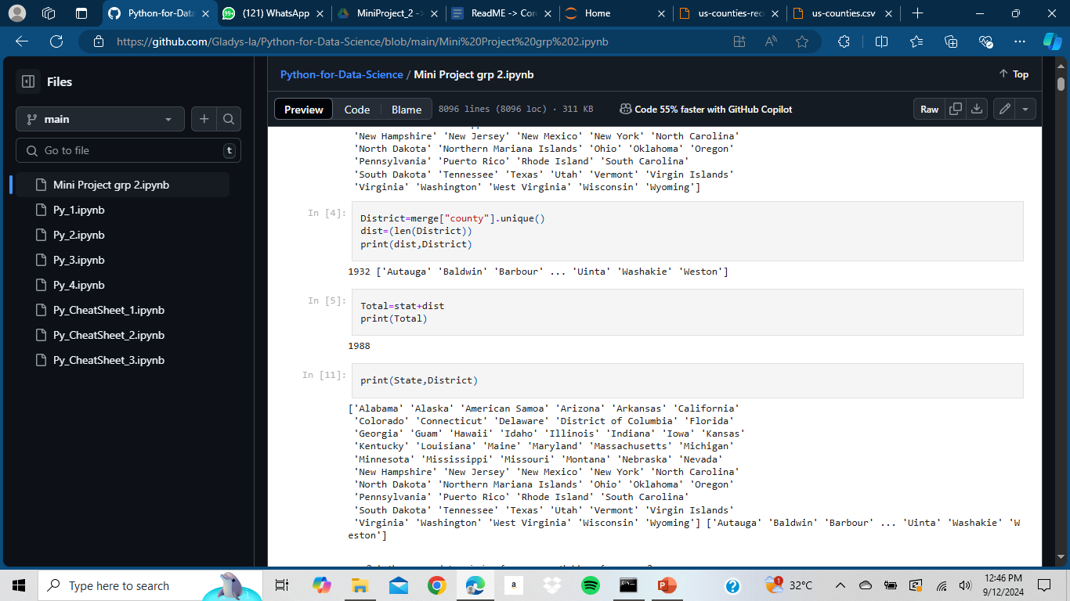

PART I Find number of distinct counties and states, number of void entiries
Output
Function Used:
.unique ()
The .unique() function in pandas is used to return the unique values in a Series or DataFrame.
Syntax: series.unique() or dataframe.column_name.unique().
.len()
The len() function is a built in Python function that returns the number of items in an object.
.isnull()
The isnull() function in pandas checks for missing or null values in a Series or DataFrame.

Slide 5


PART II Top 10 states having highest total death in the year 2020, 2021
Function Used:
.groupby
The .groupby() function in pandas is used to group a DataFrame by one or more columns and perform aggregation operations on the grouped data.
Syntax: df.groupby(by, axis=0, level=None, as_index=True, sort=True, group_keys=True, squeeze=NoDefault.no_default, observed=False, dropna=True
.sum
The .sum() function in pandas is used to calculate the sum of a Series or DataFrame.
Syntax:series.sum(axis=None, skipna=True, level=None, numeric_only=None)
.sort_values
The .sort_values() function in pandas is used to sort a Series or DataFrame by one or more columns.
Syntax: df.sort_values(by, axis=0, ascending=True, inplace=False, kind='quicksort', na_position='last', ignore_index=False)
Output

Slide 6


Top 10 states having highest average death in the year 2020, 2021
Function Used:
.mean
The .mean() function in pandas is used to calculate the mean (average) of a Series or DataFrame..
Syntax: series.mean (axis=None, skipna=True, level=None, numeric_only=None)
Output

Slide 7

Top 10 counties having highest total death in the year 2020 and 2021 together
Output
Function Used:
|
In pandas, the | symbol is used to represent the bitwise OR operation or the union of two conditions.
Bitwise OR: When used with two Series or DataFrame columns, | performs a bitwise OR operation element-wise.

Slide 8
Thank You

